Slide 1
Secure Data hiding in images using steganography
PROJECT
Student Name : Yamal Sharma
College Name & Department : Bahra University (BTech. (CSE))

Slide 2
OUTLINE
Problem Statement
Technology used
Wow factor
End users
Result
Conclusion
Git-hub Link
Future scope

Slide 3
Problem Statement
The increasing need for secure digital communication.
Traditional encryption methods can attract unwanted attention.
Steganography hides messages inside images, making it undetectable.
Ensures data confidentiality and security.
Prevents unauthorized interception of sensitive information.
Useful in cybersecurity, journalism, and military applications.
This project provides an easy and effective way to achieve hidden communication.
Helps in secure personal and professional communications.

Slide 4
Technology used
Programming Language: Python
Graphical User Interface (GUI): Tkinter
Image Processing Library: OpenCV
Encryption Concept: LSB (Least Significant Bit) Steganography
File Handling: Supports PNG image format for secure embedding.
Security Feature: Passcode protection for decryption.
Error Handling: Validations to prevent incorrect input processing.
Automation: Image selection and real-time encryption processing.

Slide 5
Wow factors
Invisible Encryption: Hides messages inside images without altering their appearance.
Passcode Protection: Only authorized users can retrieve the hidden message.
User-Friendly Interface: Simple GUI for easy encryption and decryption.
Lightweight & Fast: Works efficiently without high computational power.
Data Integrity: Hidden messages remain intact without corruption.
Multi-purpose Usage: Useful for secure communication and data privacy.
Local Processing: No internet dependency for security reasons.
Potential for Expansion: Can be extended to support audio and video steganography.

Slide 6
End users
Cybersecurity Professionals – Use for secure message transmission.
Journalists & Whistleblowers – Hide sensitive information in media.
Government & Intelligence Agencies – Secure classified communications.
Private Individuals – Encrypt personal messages securely.
Corporate Users – Protect confidential business data.
Researchers & Students – Study cryptography and data security methods.
Developers & Hackers – Explore advanced cryptography and steganography techniques.
Forensic Investigators – Detect and analyse hidden data in digital images.

Slide 7
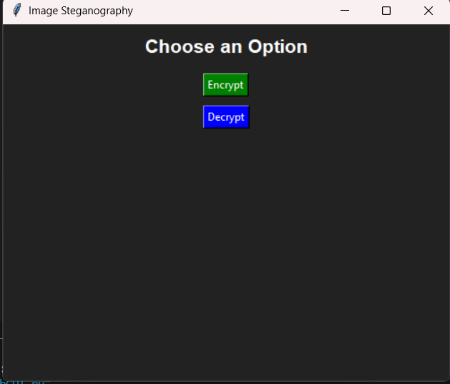
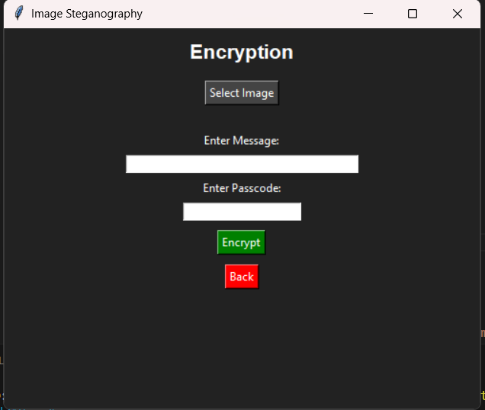
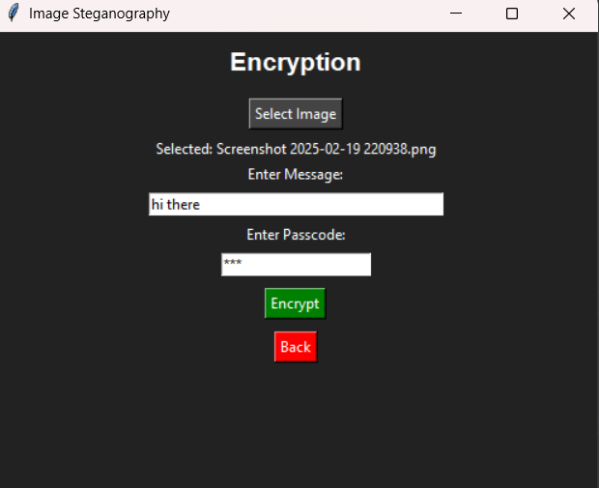
Results

Slide 8
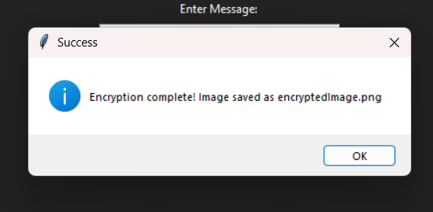
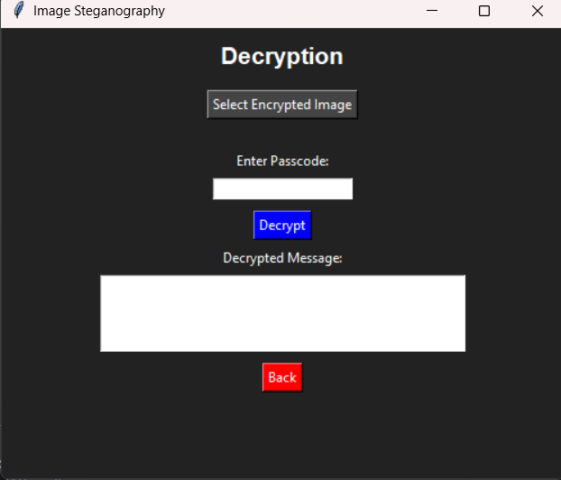
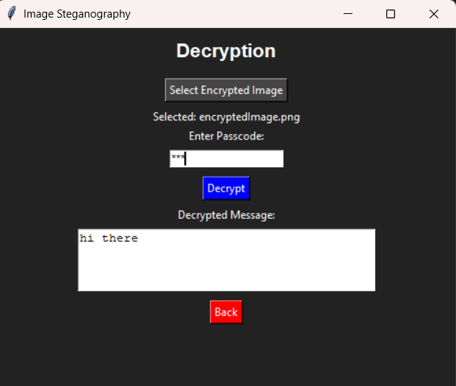

Slide 9
Conclusion
Steganography is a powerful tool for secure communication.
Hiding messages in images makes encryption undetectable.
This project demonstrates a simple yet effective implementation in Python.
The GUI makes it easy for users to encrypt and decrypt messages.
Passcode protection adds an extra security layer.
The method preserves image quality while embedding data.
Steganography can be applied in various fields, including cybersecurity.
Future enhancements can make it even more secure and versatile.

Slide 10
GitHub Link
https://github.com/YamalSharma/AICTE_CYBER_INTERNSHIP.git

Slide 11
Future scope(optional)
Audio & Video Steganography: Extend the concept to audio and video files.
Multi-layer Encryption: Add advanced cryptographic techniques for extra security.
Different Image Formats: Expand support to JPEG, BMP, and GIF formats.
Cloud Integration: Store encrypted images securely on cloud platforms.
Mobile Application: Develop an Android/iOS app for easy access.
Multi-user Support: Allow multiple users to exchange hidden messages securely.
Steganalysis Resistance: Improve detection resistance against forensic analysis.
Blockchain Integration: Secure hidden data using decentralized ledger technology.

Slide 12
THANK YOU

